Slide 1


Paris House Price Prediction
Paris House Price Prediction

Slide 2

Shivasharane Akkamahadevi
Government Women’s Polytechnic
Shiralakoppa
Project Seminar On
“Paris House Price Prediction”
Under the Guidance of :
“Umesha D K”
Lecture, department of CS&E,
Shivasharane Akkamahadevi Government
Women’s Polytechnic Shiralakoppa
Presented By :
Arpitha S
Sushmitha R S
VI – Sem, CS&E,
SAGWPT Shiralakoppa.

Slide 3
Abstract
01.
02.
Introduction
03.
Problem Statement
04.
Objectives
Table of
Contents
Requirements
05.
Implementation
06.
Testing
07.
08.
Conclusion
Notes:
i

Slide 4

Abstract
The abstract of the Paris house price prediction project for properties in Paris involves using machine learning algorithms to develop a predictive model that can estimate the prices of properties in the city based on various features such as Square meter, Number of rooms, floors, Category and so on.

Slide 5


Introduction
House price prediction leverages data analysis and machine learning techniques to estimate rental prices for residential properties. It's a valuable tool for property owners, tenants, and paris house professionals looking to make informed decisions about renting or leasing properties.

Slide 6
Problem Statement
The problem statement of house rent prediction typically involves creating a model or system that can accurately predict the rental price of a house or apartment based on various features or factors. The aim is to develop a predictive algorithm that takes into account variables such as location, size (number of bedrooms, floors, square footage), amenities, neighborhood, local market trends, and other relevant factors to estimate the rental price of a property.

Slide 7

Objectives
To predict the prices according to the locality. To predict the house rents in the upcoming future and can plan to shift to a particular location by knowing the house rents in a locality.

Slide 8



07.
Requirements
Hardware Specification:
Software Requirements:
Processor : Intel core 15
Processor Speed : 1.75GHZ to 2.40GHZ
RAM : 4GB
Hard Disk : 4GB to 30GB
Language : Python
IDE : Jupyter Notebook
Operating System : Windows 8/10

Slide 9
Implementation
USER
INPUT DATA
PREPROCESSING
OF DATA
SPLITTING
OF DATA
TRAINING
TESTING
RESULT

Slide 10
Result/Output
The focus of this research paper is to design a model and analyze the performance of various Machine Learning algorithms and predict the most accurate algorithm for the predicting of House rent. This research was done using techniques of Logistic Regression, Random Forest, Decision Tree, Support Vector Machine on the dataset.
Method | R2-Score | MSE
Linear regression | 0.999 | 0.017
Logistic Regression | 0.345 | 0.15
Decision Tree Regressor | 0.999 | 0.3809
Random Forest Regressor | 0.999 | 0.016
Support vector Regressor | 0.659 | 0.065

Slide 11
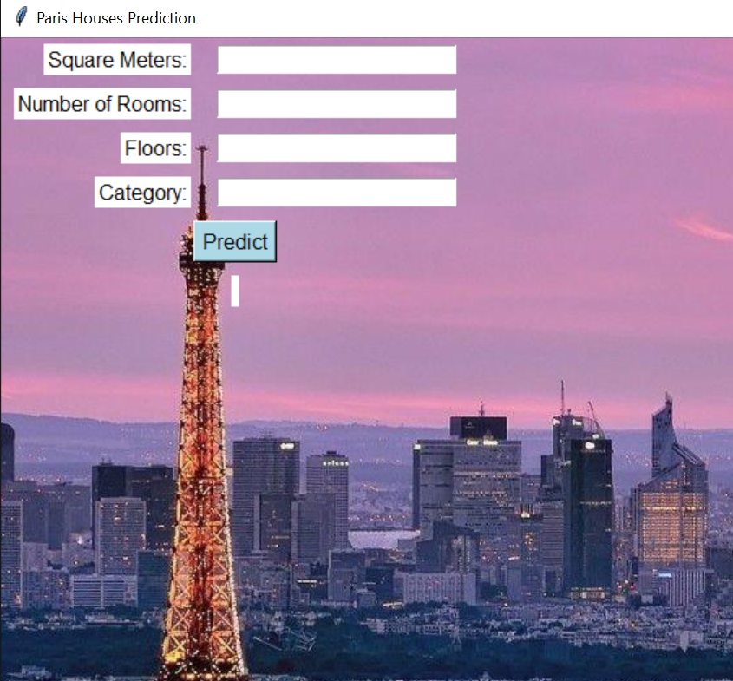
Home Screen
Here user can
enter input details

Slide 12
Conclusion
In this research paper, the primary goal is to estimate the rent of a residence by examining the demands of the client and their financial situation. This study paper will assist the clients in learning the actual rent for the residence, and it will assist the owners in learning the rental rate that best suits the client& requirements. The comparison of all the algorithms gives the results but Random forest regression gives the best results among all the algorithms. Because random forest have less mean absolute error and root mean square error compare to other algorithm and Random forest have 99% of R2_score, so it is consider to the best one.

Slide 13

THANK YOU

